Slide 1
2020 CENSUS ENTERPRISE ARCHITECUTRE AND INFRASTRUCTURE TRANSITION PLAN
George Mason University
INFS 774: Enterprise Architecture
Professor Barry Barlow

Slide 2
Meet the team
Team Member | Assignments
Linus Freeman | EA Framework Selection and Customization Enterprise Architecture Business View
Nicholas Vilailack | Enterprise Architecture System View Project Report Overview
Junxiang Wang | Enterprise Architecture Technical View EA Framework Overview

Slide 3


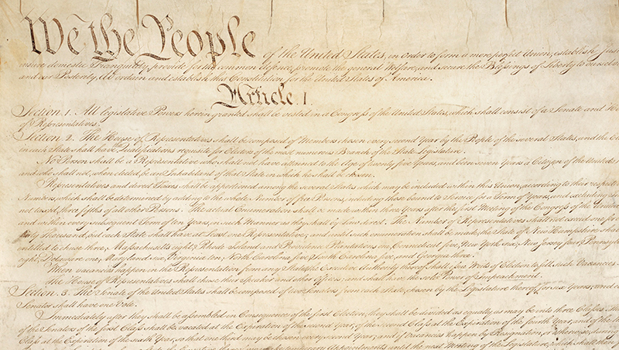

United States Census Bureau
Notes:
The Constitution of the United States (Article I, Section 2) directs the population be enumerated every 10 years.

Slide 4
Census Bureau collects data
Count residents of the United States
Within 4 statistical regions (9 divisions in total)
Northeast, South, Midwest, and West
Conducts various surveys
Surveys range from economics to housing to healthcare to finance
Notes:
Helps the Federal, State, and Local governments to make decisions usually involving money.

Slide 5
Use of Census data
Decide the location of new housing
Examine demographics of various regions
Plan transportation systems and roadways
Determine quotas for police and fire stations
Determine number of seats for each state within the house of representatives
Determine number of electoral votes for each state during the Presidential elections
Notes:
The U.S population is growing, some places more than others. The use of census data with statistics can help lawmakers make better choices and provide rationale for their decisions.

Slide 6
Ea system view
George Mason University
INFS 774: Enterprise Architecture
Nicholas Vilailack
Professor Barry Barlow

Slide 7

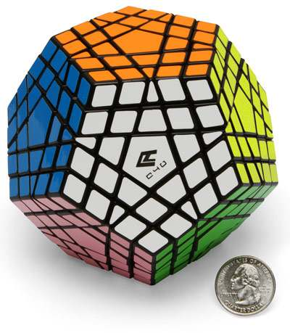



AS-IS (BASELINE)
Notes:
Manual Process (Using Pallet Jack) Not much automation, much of the data transfers were manual.
Highly complex (Advanced cube) Very complex and not in a good way. Having different systems and applications not working in harmony.
Wrist watch, house phone, camera all of these things doing a separate function which eats up time, money, and resources.

Slide 8
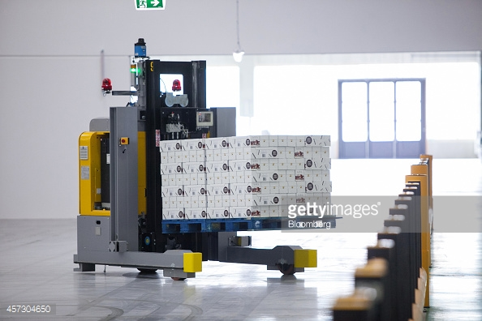
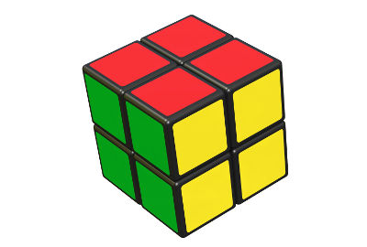

TO-BE (FUTURE)
Notes:
Automatic forklift which is programmed via logic to get boxes from one point to another. Still programmed by humans (manual) but more automatic.
Simpler Rubix Cube-Still the same concepts as before but much more simplified and easier to understand/take apart/implement when needed.
Galaxy S8=Takes all of the functions of the previous and puts it into the one integrated system/solution.

Slide 9
Transition
AS-IS (BASELINE) | TO-BE (TARGET STATE)
Highly complex | Simplified but efficient
Integration of existing + new solutions | Only use what is needed solutions
Crosses several platforms | Only cross needed platforms
Multiple Hardware and Software | Integrate only what is needed
Multiple data sources | Have all data sources aggregated
Little automation, mostly manual process | More automation, less manual
Database links | Enterprise wide methods
Less sharing from lack of ability | More sharing of data
Notes:
Easy to read table that shows the as is differences from the to be targets.
These things are easy to understand and most people can see why they want the target state to be like that.

Slide 10
My thoughts
The Census Bureau is trying to make the best use of tax payer money to accomplish its goal
It’s wants to get the most value from the data collected so that decisions makers have info
It’s doing multiple tests from 2015-2019
To get ready for the 2020 Census
Bold goals every year lead to slim error margins
Staying on schedule will be very difficult
High risk taken to meet goals/stay on schedule
Trying to spend money that isn’t provided yet
Notes:
Having small tests/work load balancing is not the same as having a full scale census.
Going from A to B to C to D to get the final F could be troublesome.
The small tests estimate and don’t take into account some complex factors plus unseen problems may occur (system X will not be able to handle the full data load of a true census)
The bold goals will be supplemented with example Asking for $500 million to get testing done 1 year what happens when you get much less than the amount you want?
Overestimating budget requests and underestimating costs/time usually lead to disaster.

